Slide 1

BY :- Vivek Kumar
Paras Kumar
Mayank Mishra
Kanhaiya Mishra
Suraj Singh Bani

Slide 2
Introduction
Project?
It is a unique transient endeavor undertaker to achieve planned objectives which could be defined in terms of outputs, outcomes or benefits.
Project Management?
It is the application of methods, knowledge, skills and experience to achieve the project objectives.

Slide 3
Project Management System
BASIC STRUCTURE
Introduction
Objective/Aim
Existing vs. Current
Technical Specification
DFD & ER Diagram
Schema Builder
Scope of Project
Limitation of Project
Future of Scope

Slide 4
Salesforce: A Cloud Computing Platform
Salesforce
Project
Management
Project

Slide 5
Objectives and Motives of our project
An awareness of the importance of applying good practice Project Management in projects of any size.
An understanding of essential elements, including the Leadership Role of the Project Manager, Project Planning, Risk Management.
Implementing the functionalities provided by salesforce platform and making it user-friendly as much as it is required.

Slide 6
SOFTWARE USED
SALESFORCE
LANGUAGE USED
CSS
HTML
APEX

Slide 7
OBJECTS
Project
Client
Employee Groups
Accounts Invoice

Slide 8
Flowchart
Client
Invoice
Chatter
Project
Accounts
Employee
Group

Slide 9
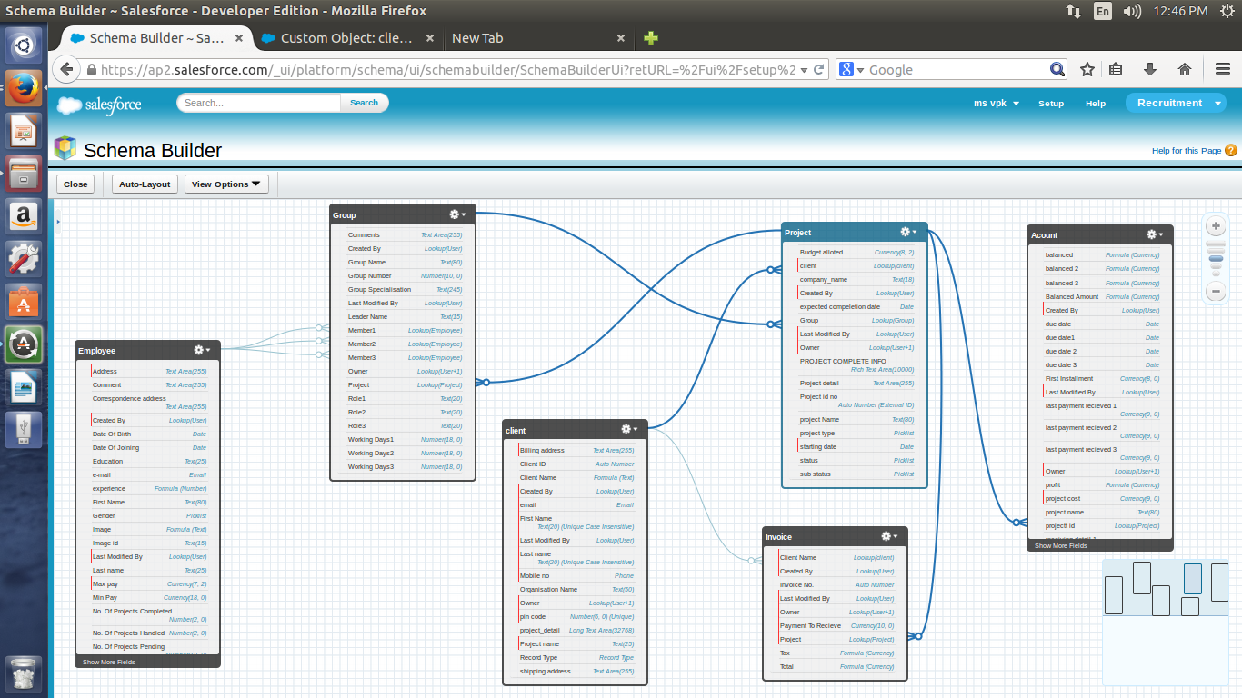
Schema Builder

Slide 10
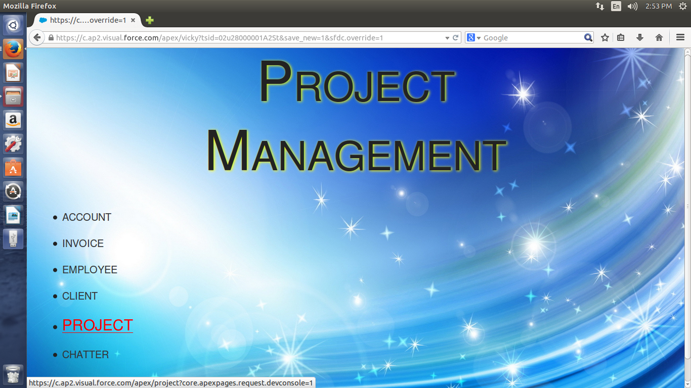

Slide 11
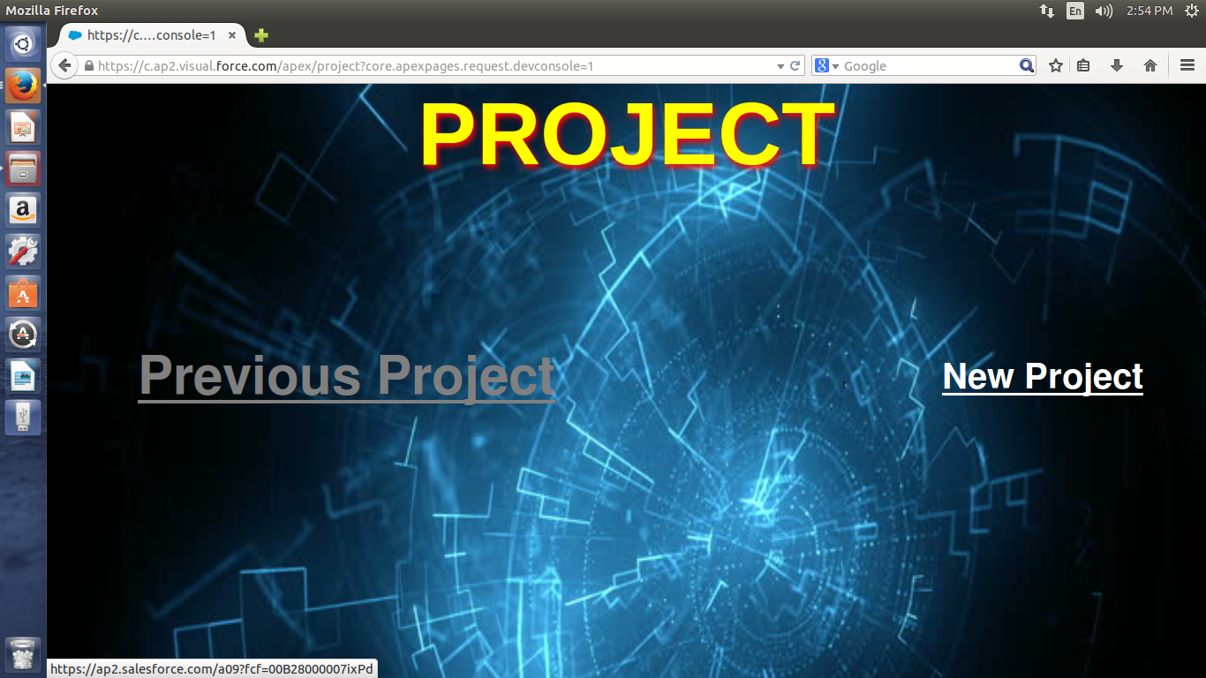

Slide 12
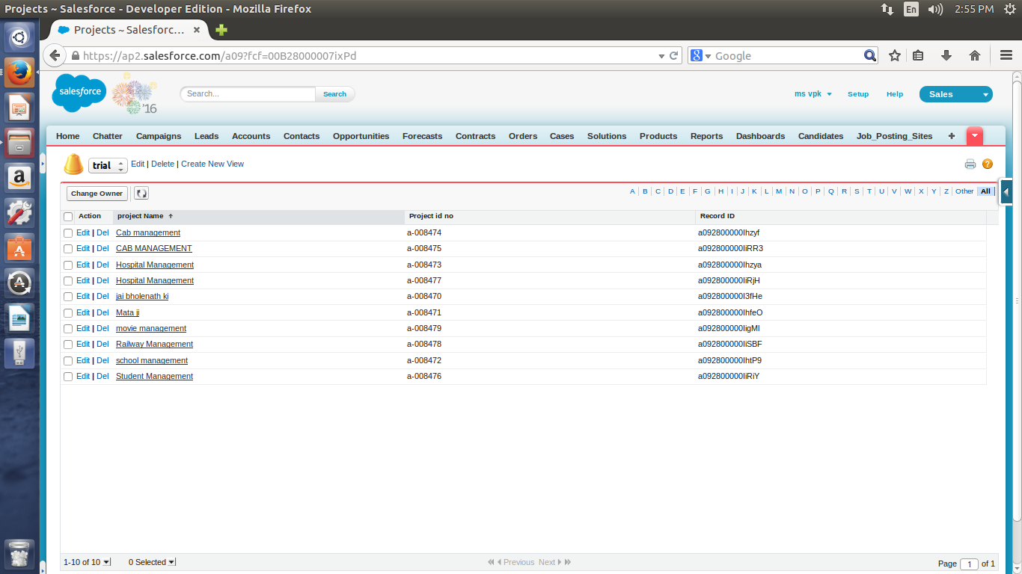

Slide 13
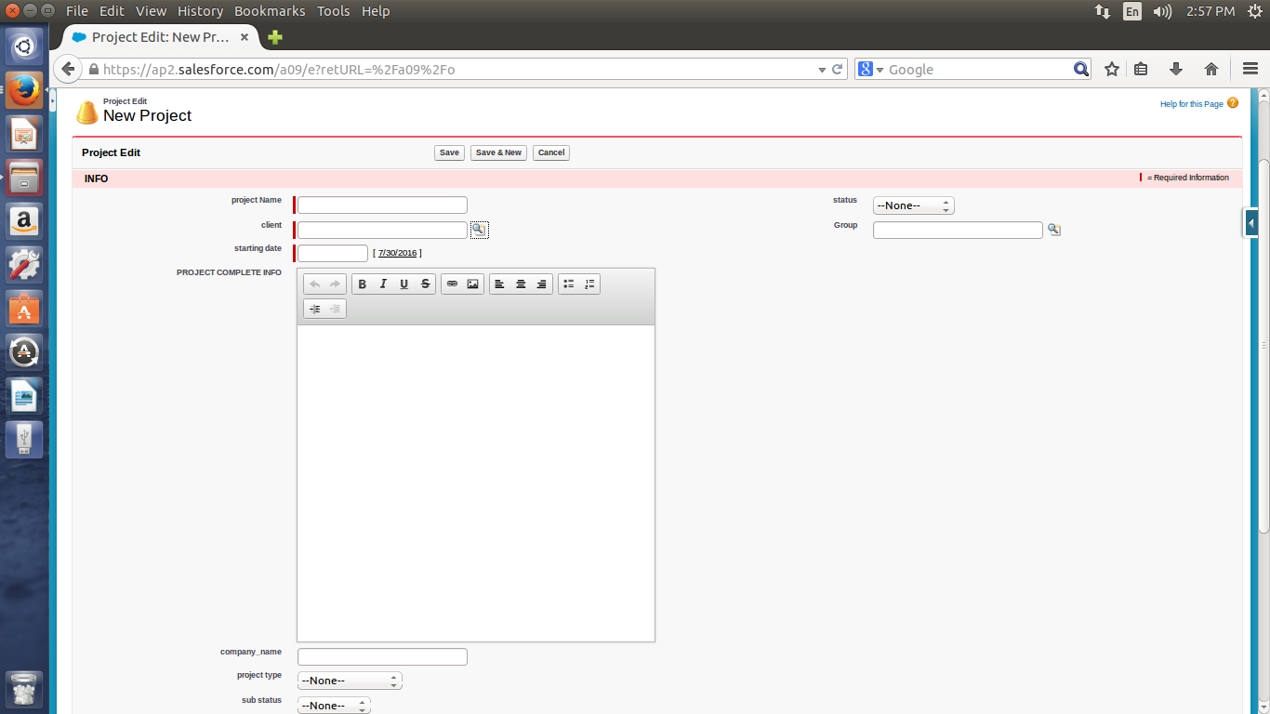

Slide 14
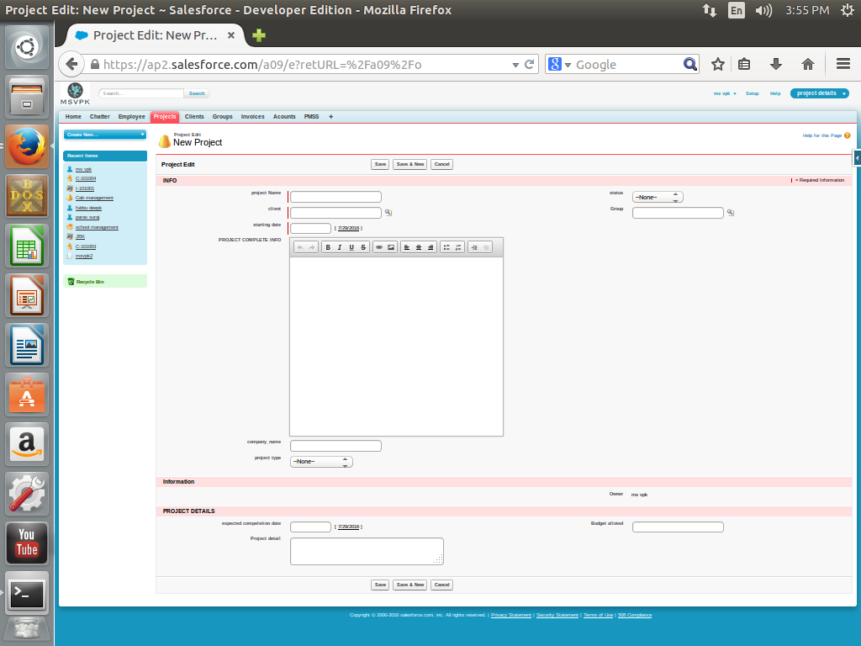
Project Fields

Slide 15


Slide 16
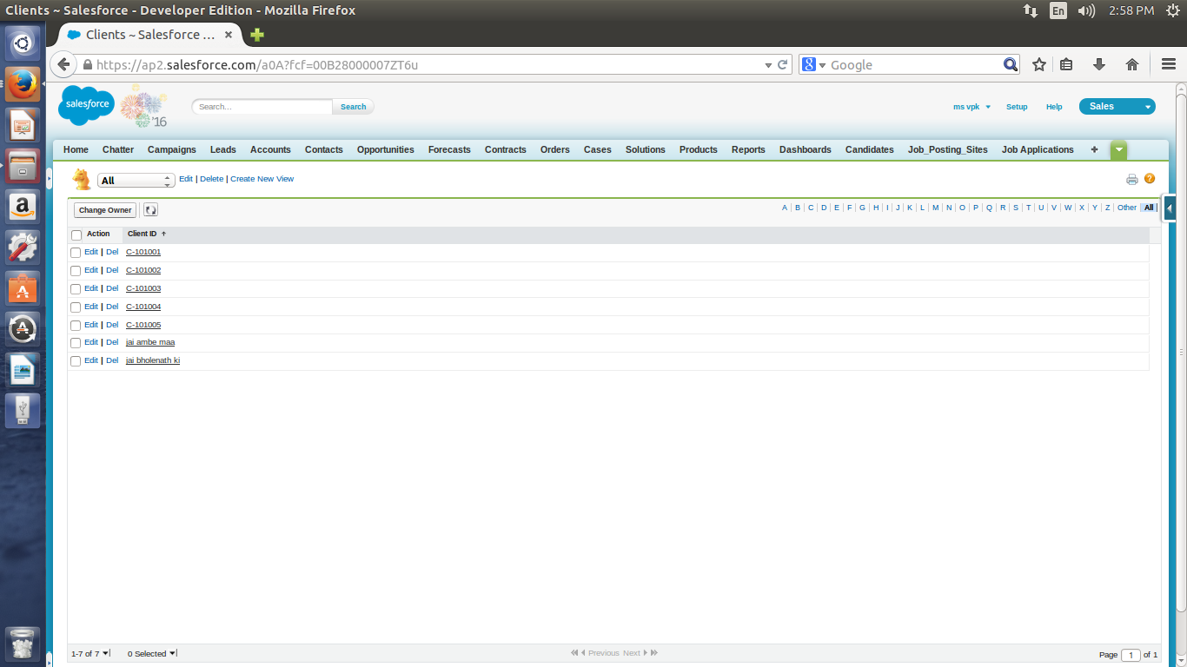

Slide 17
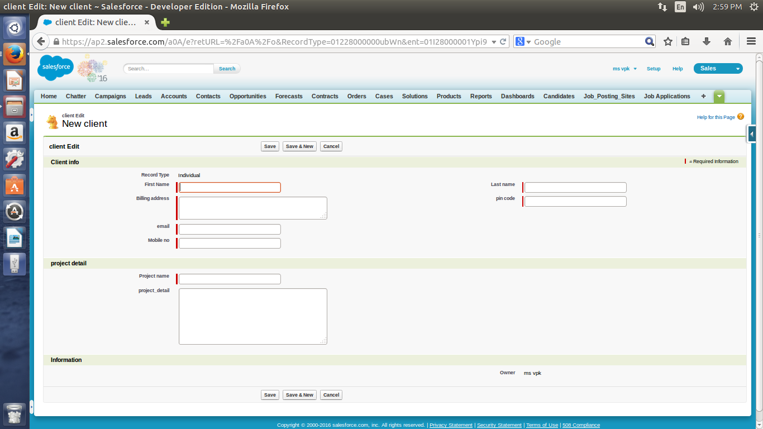

Slide 18
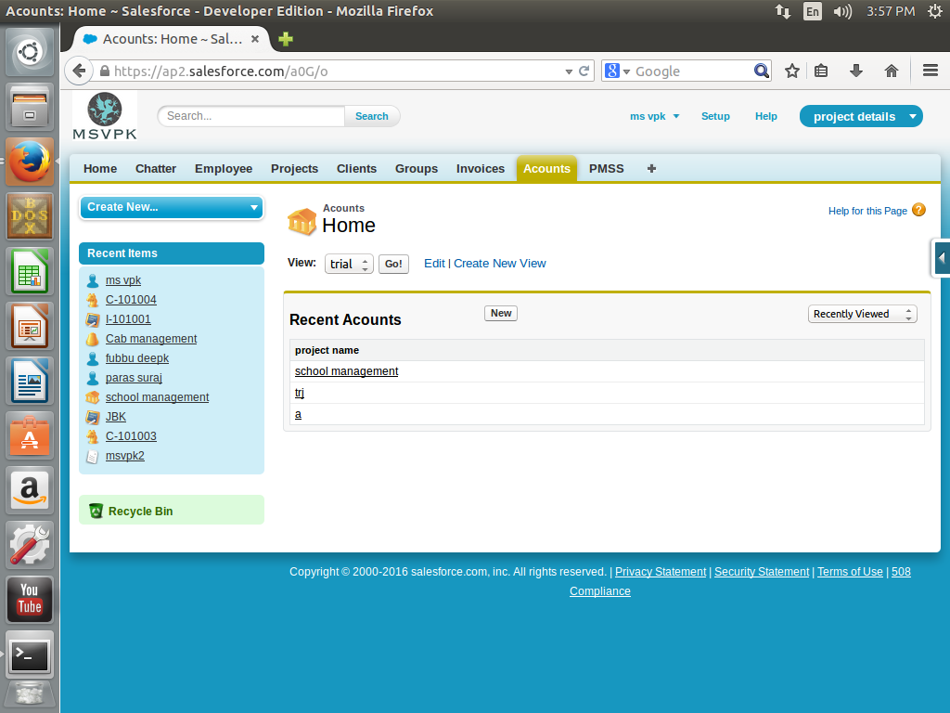
Accounts

Slide 19
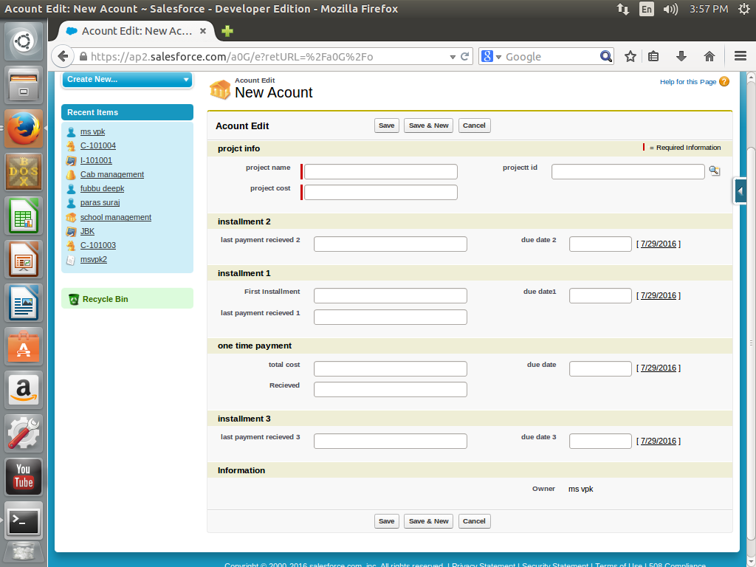
Accounts Fields

Slide 20
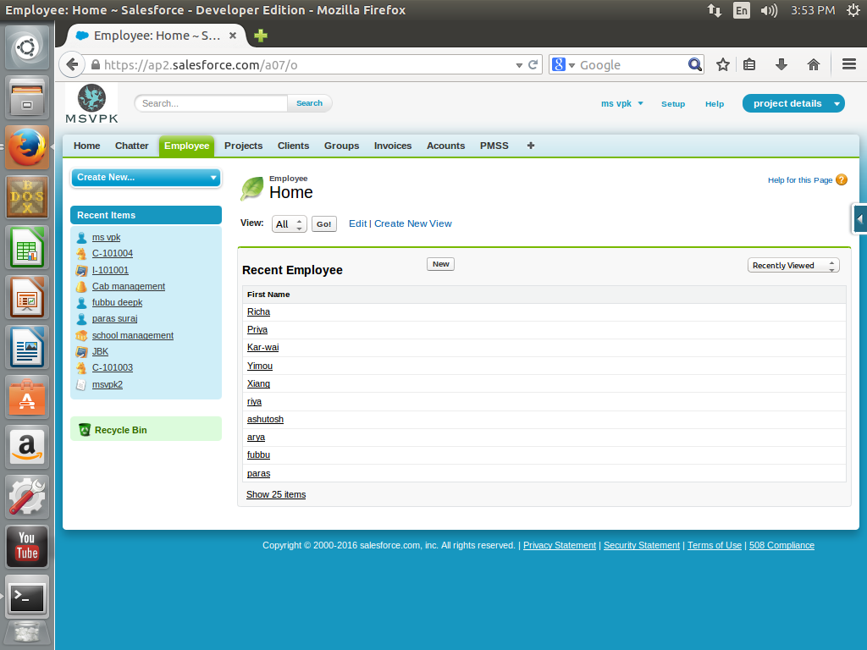
Employee

Slide 21
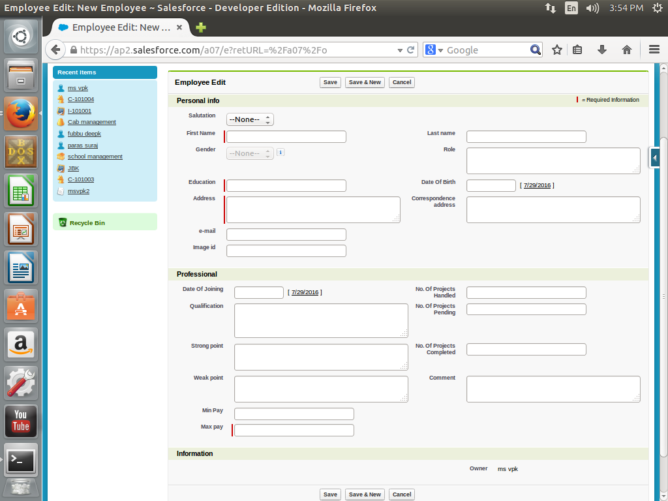
Employee Fields

Slide 22
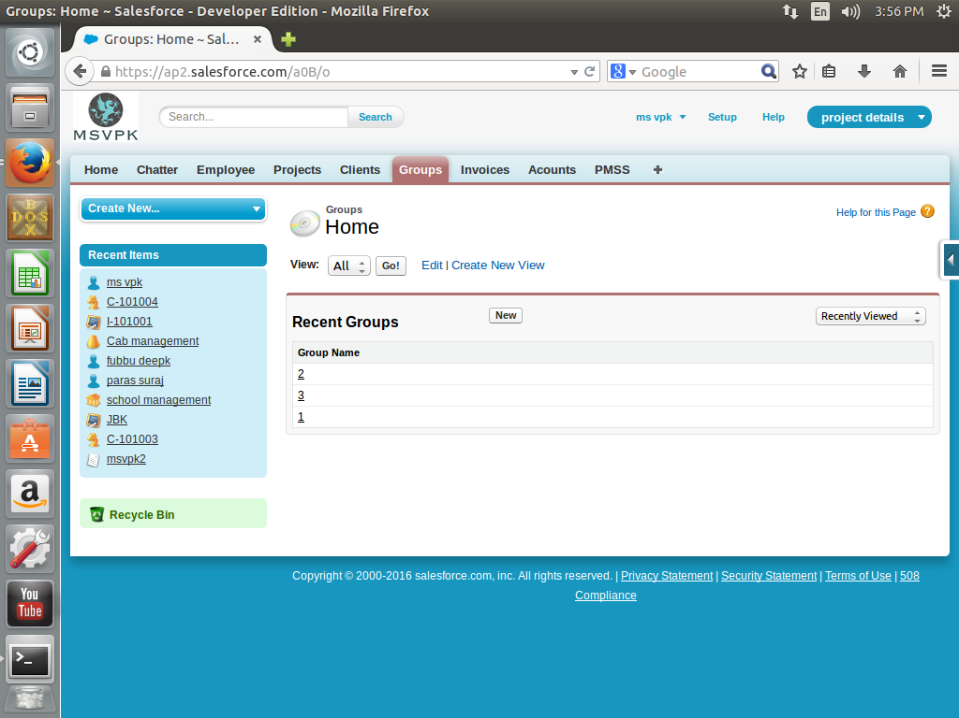
Groups

Slide 23
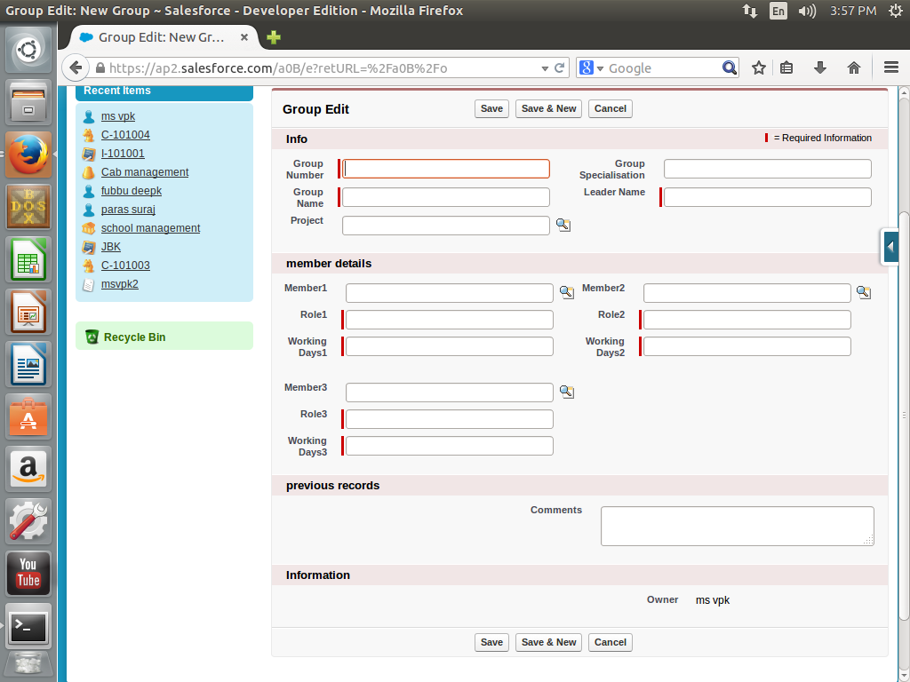
Group Fields

Slide 24
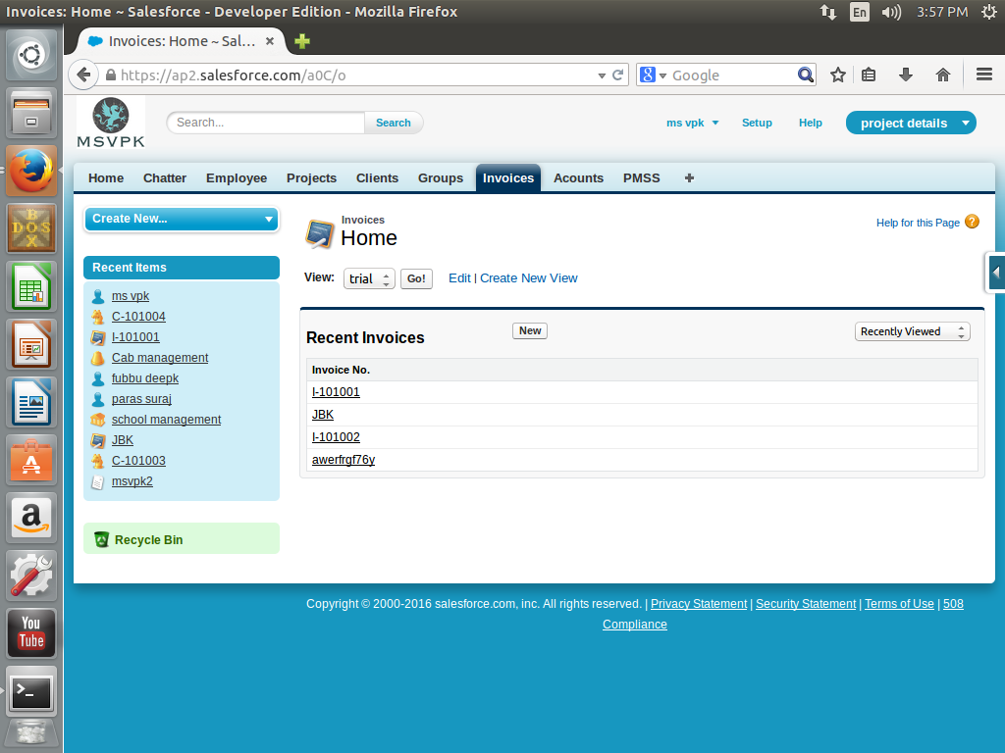
Invoice

Slide 25
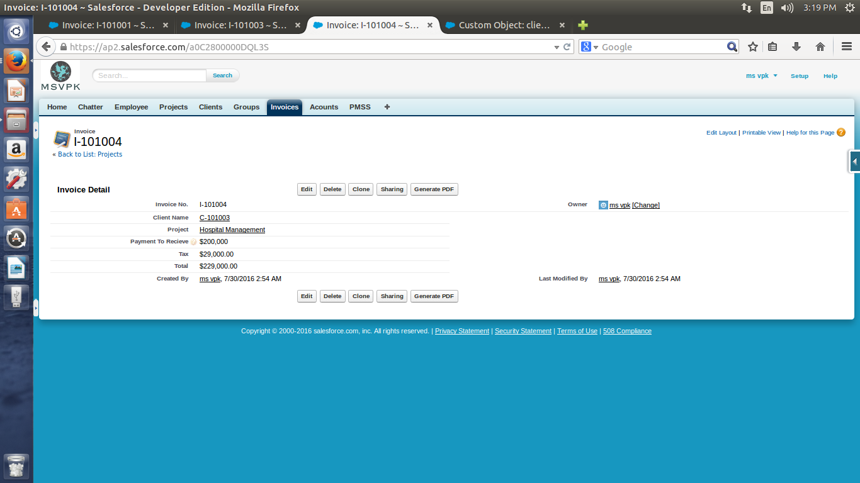

Slide 26
Scope of the Project
Manage Client Projects.
Track Invoices.
Track Bills of a Project.
Track no. of Days Worked on Project.
Track no. of Hours Worked on Project.
Create Invoice to be Send to Client.
Track the Balance Amount Left on Project.
Approval of project via hierarchy.
Backup of Data

Slide 27
Limitations of Project
Bill generation
Self tracking of previous client
Limited user
Limited permission

Slide 28
Future Scope
AS THE IT SECTOR IS GROWING SO IS THE REQUIREMENT OF APPS.
WITH MORE UPGRADATION AND ENHANCEMENT IT WILL COME ON IT OWN TO COMPETE IN MARKET

